Slide 1
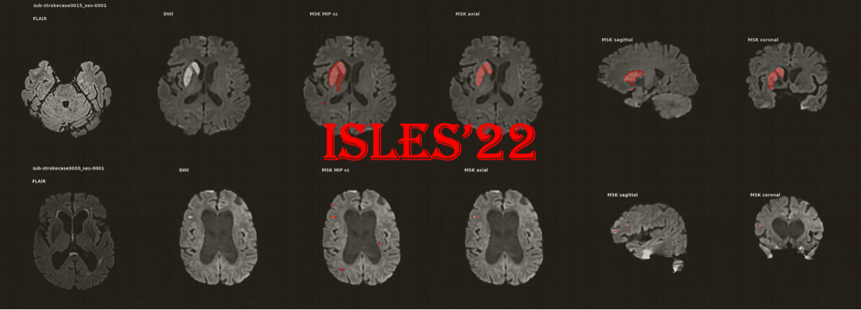
Review on Ensemble techniques in Computer Vision for segmentation by
PUNITH N
Student ID : 1135354
Email : P.N@2024.ljmu.ac.uk

Slide 2
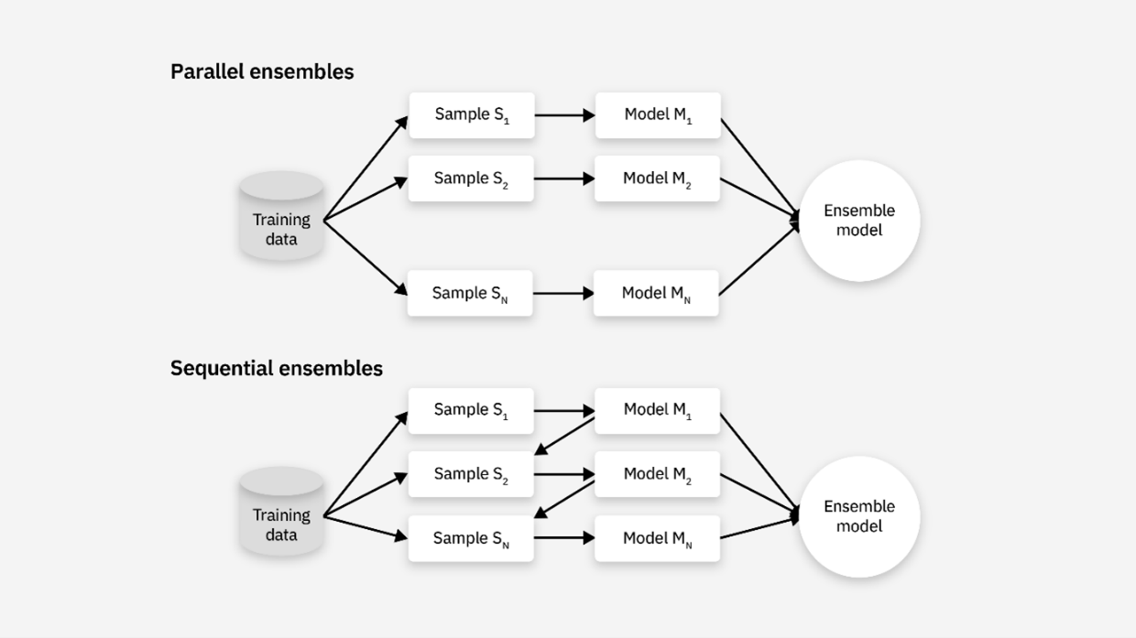
Introduction and Background
In Computer vision, image segmentation is core process, teaching machines to comprehend images at a pixel level.
Ensemble learning is basically the idea of "two heads are better than one" applied to machine learning. take multiple simple algorithms and have them "vote" on a result
An Ischemic Brain stroke is an event caused by a blockage in the blood flow to the regions of the brain. ​This personal experience after an accident has fueled my passion to choose medical image segmentation topic.

Slide 3
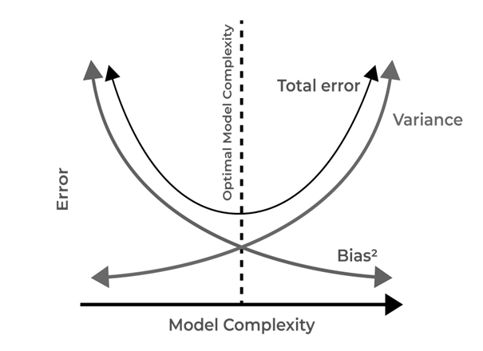
Ensemble methods are mainly used to tackle the bias-variance trade-off
Bias refers to a systematic error in a model's predictions, often due to faulty assumptions or unrepresentative data during the learning process.
Variance High variance indicates that a model is very sensitive to the specific training data. Means it performs well on the data it was trained on but poorly on any new data it encounters.

Slide 4
    Experimental Setup:
    Data Preparation: The ISLES'22 dataset undergoes pre-processing, including skull-stripping (as provided by source), and then dividing the data into respective Train/validate/Test sets.
    Training Protocol: We will establish detailed training procedures for both individual base models and their subsequent ensemble configurations. This involves carefully selecting appropriate loss functions (e.g., Dice loss, Focal loss, which are well-suited for imbalanced medical data), optimizers, and learning rates.
    Implementation: The study will leverage common deep learning frameworks, such as PyTorch or TensorFlow, along with relevant libraries for image processing and model development.
    Evaluation and Results:
    Evaluation Metrics: models and methods are evaluated using metrics used for medical segmentation. These includes the Lesion-wise F1-Score, Dice Score (DSC) and Absolute Volume Difference (AVD).
    Comparative Analysis: The performance of the ensemble models will be directly compared against each individual base model to quantify the improvement achieved through ensembling.
    Statistical Significance: Appropriate statistical tests will be applied to assess the significance of any observed performance differences.

Slide 5
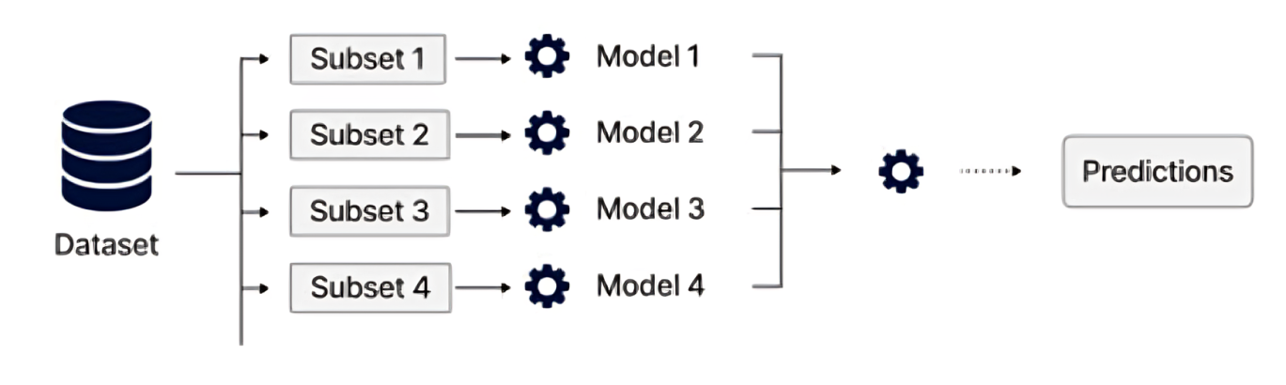
Bagging.
Training the "Committee”: You don't want your experts to all have the exact same background, or they might all make the same mistake. So, you give them slightly different experiences.
The Data: Think of data as a big library of textbooks.
The "Experts": These are individual AI models.
The Training: Instead of giving every expert the entire library, you create a unique "reading list" for each one.

Slide 6
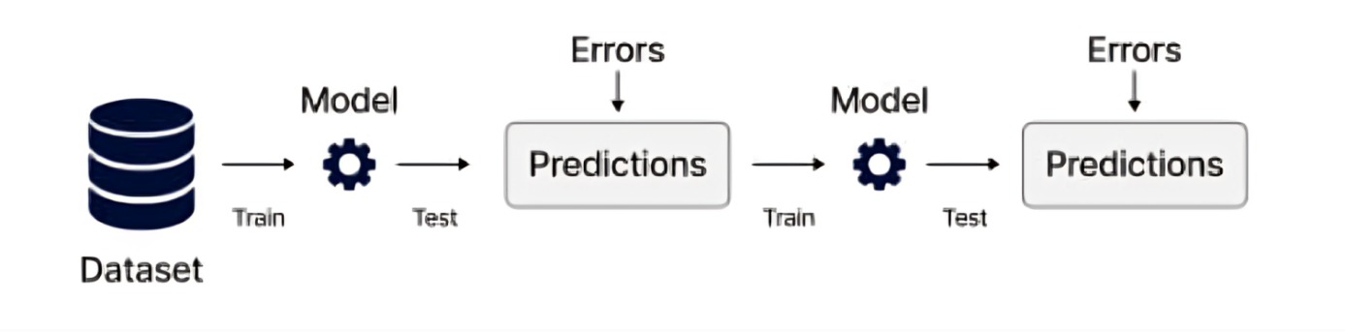
Boosting is "Learning from Mistakes" Strategy
Imagine a team of students studying together for a difficult exam. Instead of studying independently, they work one after another, with each student focusing on the mistakes made by the one before them. This is the core idea of Boosting.
It's another "team-based" approach like Bagging, but the strategy is completely different.
How the Team Works (The Process)?
This is a step-by-step, sequential process:

Slide 7
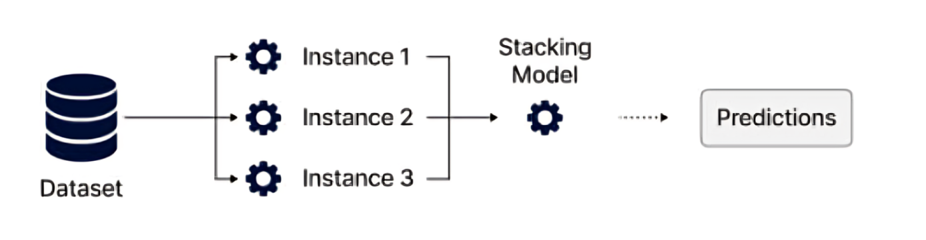
Stacking (Stacked Generalization)
In Simple Terms: The "Smart Manager" Strategy
Imagine you have a very complex medical case. Instead of relying on one doctor, you assemble a team of specialists: a radiologist who excels at reading scans, a pathologist who is an expert on tissue samples, and an oncologist who understands the disease's progression.
They each analyse the case and write up their own report.

Slide 8
Literature Review
Advancements in Image Segmentation Using Deep Learning.
Image segmentation is the process of partitioning a digital image into multiple image segments or regions to simplify the representation and make it more meaningful. Deep learning models have shown the potential to completely transform the diagnosis of stroke.
Traditional Image Segmentation Techniques
  Edge detection
  Threshold-Based Segmentation
  Clustering and Region-Based Techniques
  Clustering-Based Segmentation
  Region-Based Segmentation
Advanced Segmentation Approaches
  Semantic Segmentation
  Instance and Panoptic Segmentation

Slide 9
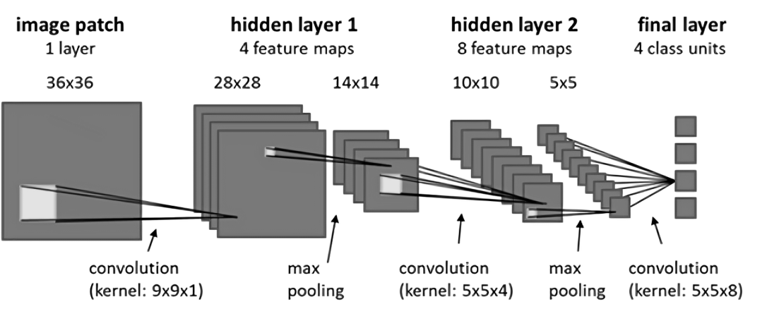
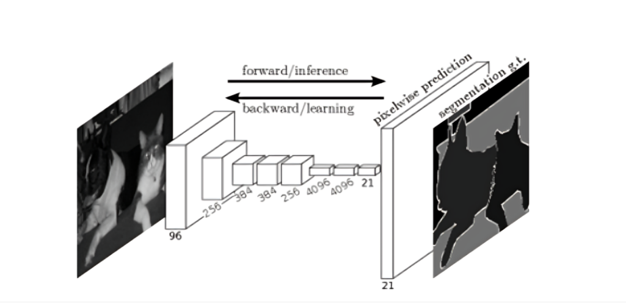
Recent Approaches in medical image Segmentation
CNNs remain the leading force in computer vision, particularly in image segmentation. Their strength lies in its ability to learn features from image, which is why they form the foundation of numerous high-performing segmentation models.
Fully Convolutional Networks (FCNs): neural network architecture, specifically designed for semantic segmentation tasks, that leverage convolutional layers throughout the entire network.

Slide 10
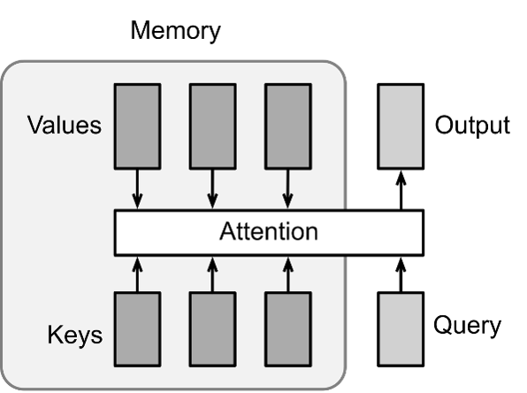
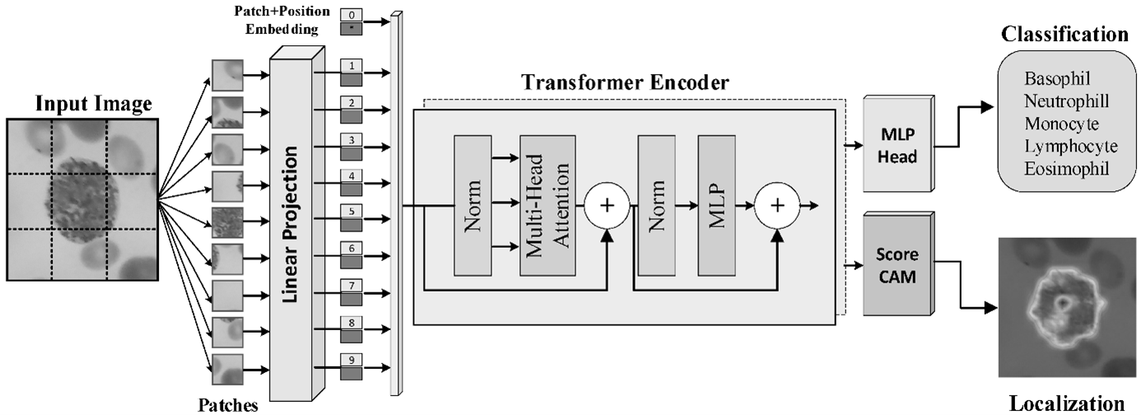
Recent Approaches in Image Segmentation
Attention Mechanisms
https://en.wikipedia.org/wiki/Attention_
Attention mechanisms are used in medical image segmentation to improve model performance by focusing on relevant information
Transformer-based Models
https://en.wikipedia.org/wiki/Transformer_
A Transformer is composed of stacked encoder layers and decoder
layers(Transformer-based models are a promising alternative to
CNNs)

Slide 11
Research methodology
Study employs a quantitative research methodology, which is most appropriate for the task of stroke lesion segmentation using machine learning techniques. The quantitative nature of study enables us to evaluate the accuracy and efficiency across various top performing algorithms submitted to ISLES’22 challenge.
Quantitative methods :
allow us to measure the performance of our ensemble algorithm using standardized metrics such as Dice Similarity Coefficient (DSC) and lesion-wise F1 score
Large Dataset Analysis:
The ISLES 2022 dataset comprises 400 multi-vendor MRI cases with high variability in stroke lesion size, quantity, and location. A quantitative approach is best suited to analyze such a large and diverse dataset
Compatibility with Machine Learning:
Study heavily relies on machine learning techniques, particularly deep learning and ensemble methods, which inherently produce quantitative outputs.

Slide 12
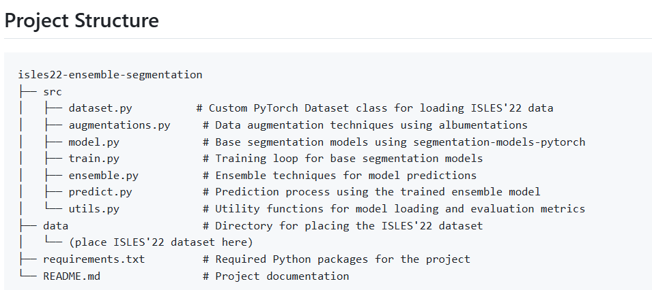
IMPLEMENTATION
Implementation plan for creating an ensemble learning for image segmentation, particularly focusing on approach = in a Google Collab environment using the ISLES'22 dataset as a case study.

Slide 13
IMPLEMENTATION
Implementation plan for creating an ensemble learning for image segmentation, particularly focusing on approach in a Google Collab environment using the ISLES'22 dataset as a case study.
STEP 1 : INSTALATIONS AND IMPORTS.
nibabel as nib | For reading NIfTI medical image files
tensorflow as tf | For TensorFlow functionality (though noted as optional)
torch | PyTorch deep learning framework
numpy as np | For numerical computations
matplotlib.pyplot as plt | For plotting and visualization
segmentation_models_pytorch | to use for image segmentation built in models.
SimpleITK as sitk | For medical image processing
tqdm | For progress bars
logging | For logging messages
shutil | For file operations
Albumentations | For image augmentation
nibabel | For handling NIfTI medical image files
OpenCV-python | For image processing
segmentation_models_pytorch | For pre-built segmentation models
torch | PyTorch deep learning framework
TensorFlow | Another deep learning framework

Slide 14
STEP 2(OPTIONAL) : MEDICAL IMAGE PRE_PROCESSING PIPELINE(ISLES-2022)
apply_n4_bias_correction | Removes intensity inhomogeneities from MRI images using N4 bias field correction
register_image_and_mask | Aligns images using registration with mutual information metric
create_comprehensive_overlay | Creates RGB overlays for visualization
preprocess_subject | Main function that processes an individual subject's data

Slide 15
STEP 2 : HELPER FUNCTIONS AND DATALOADER.
Dice Loss/Score | Implements Dice loss and Dice coefficient for segmentation evaluation.
Padding/Cropping | Functions to pad/crop 2D/3D tensors to required shapes for model compatibility.
Evaluation Metrics | Functions for Absolute Volume Difference (AVD) and pixel-wise F1 score.
Visualization | Functions to plot input images, ground truth masks, and predictions for 3D volumes (slice-by-slice).
Custom Dataset | ISLESDataset3D` loads DWI, ADC, and mask NIfTI files, stacks modalities, and returns tensors.
Pad Collate | Custom collate function for DataLoader to pad batches to the largest shape in the batch.

Slide 16
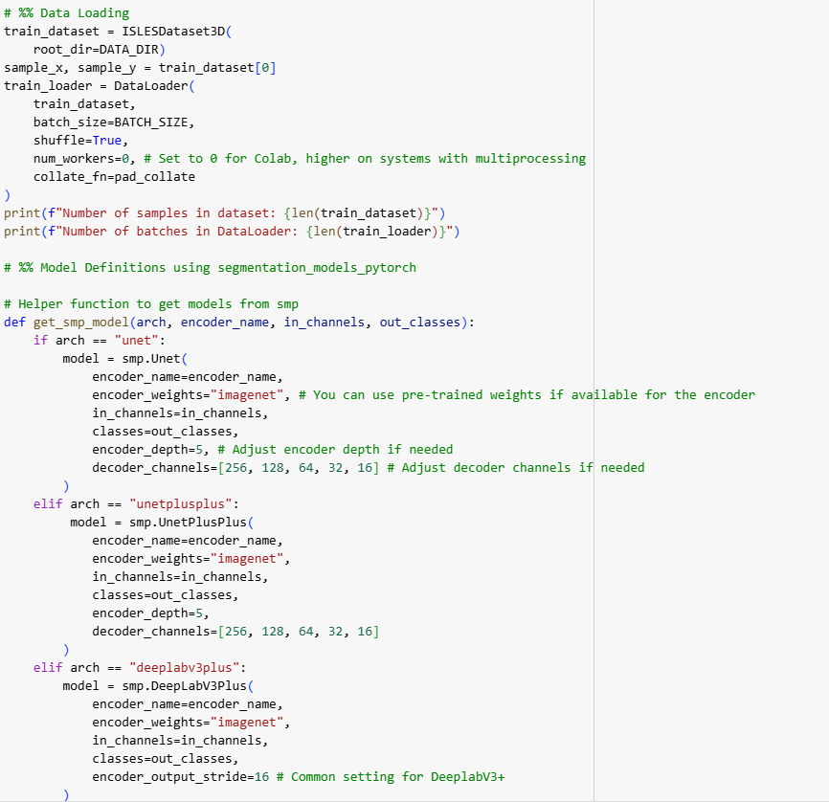
STEP 3 :DATA LOADING AND MODEL DEFENITIONS.
Loads the dataset using `ISLESDataset3D` and prepares a DataLoader.
Defines a helper function `get_smp_model` to instantiate SMP models (UNet, UNet++, DeepLabV3+, LinkNet) with configurable encoders.
Specifies a dictionary of model architectures for ensemble training.

Slide 17
Step 4. Bagging (Model Averaging) Ensemble Training
Bagging: Trains multiple independent models (with different architectures/backbones) on the same data.
Training Loop: For each model, trains slice-by-slice (since SMP models are 2D), pads inputs to required size, computes Dice loss, and saves model weights.
Model Saving: Each trained model is saved to Google Drive and its path is stored in `model_paths_dict`.
Step 5. Ensemble Prediction (Bagging)
Model Loading: Loads all trained models from `model_paths_dict`.
Ensemble Prediction: For a batch, each model predicts slice-by-slice; predictions are averaged and thresholder to produce the final mask.
Visualization: Plots DWI/ADC input, ground truth, and ensemble prediction for a slice containing a lesion

Slide 18
Step 6: Boosting ensemble
Boosting Setup: Creates a sequence of 3 models, UNet with ResNet18 backbone for all modelsBoosting Prediction: Loads boosting models, averages their predictions, and evaluates ensemble performance.
N_BOOSTING_MODELS | 3
BOOSTING_MODEL_CONFIG | unet_resnet18
Step 7. Stacking Ensemble
Stacking Concept: Training several models, and then will use all model’s prediction for meta-model.
Base Model Training: Trains and saves one instance of each architecture.
Meta-Feature Generation: (Commented out) Would collect base model predictions on a validation set to use as input for the meta-model.
Meta-Model: (Commented out) Suggests a simple 3D CNN as a meta-model to combine base model outputs.

Slide 19
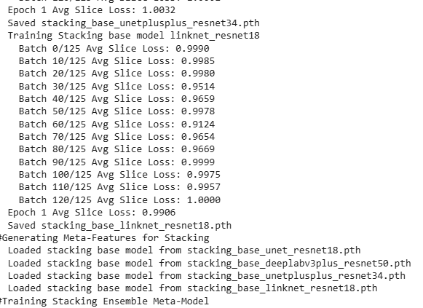
Step 8. Individual Model Evaluation
Evaluation: Loads each ensemble model, predicts on a batch, computes Dice, AVD, and F1 for each slice, and averages metrics.
Visualization: Plots predictions for a chosen slice for each individual model.
Individual Model Evaluation Summary:
Model 0: Avg Dice=0.0027, Avg AVD=inf, Avg F1=0.0000
Model 1: Avg Dice=0.0057, Avg AVD=inf, Avg F1=0.0044
Model 2: Avg Dice=0.7075, Avg AVD=31.2500, Avg F1=0.0000
Model 3: Avg Dice=0.0061, Avg AVD=inf, Avg F1=0.0057

Slide 20
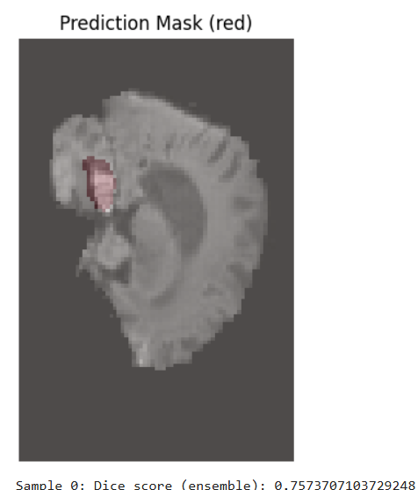
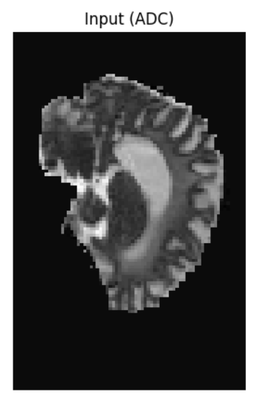
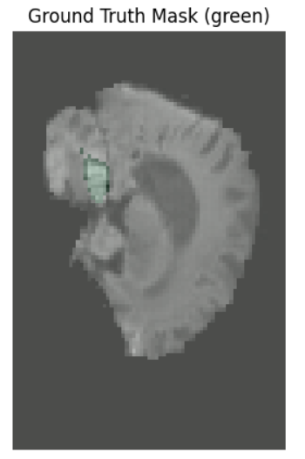
Step 9. Ensemble Evaluation and Visualization
Ensemble Prediction | This method Uses all loaded ensemble models to predict and average outputs on a batch.
Visualization | This method plots ensemble prediction for a chosen slice.

Slide 21
A REVIEW ON ISLES'22 ISCHEMIC STROKE LESION SEGMENTATION CHALLENGE
Key Components of the Ensemble Learning Approach used in challenge
Algorithm Combination: The ensemble integrates the outputs of three top-performing segmentation algorithms from the ISLES'22 MICCAI Challenge.
Majority Voting Mechanism: Idea behind this method is the majority voting mechanism. Each of the three input algorithms processes the MRI data independently and produces a segmentation output. For each voxel in the image, the ensemble counts the votes for each possible label (e.g., lesion or non-lesion) from the three algorithms. The label that receives the most votes is assigned to the voxel.(de la Rosa et al., 2024b)

Slide 22
Ensemble learning Discussion & Results
The ensemble leverages the strengths of the top three leading algorithms and employs a majority-voting scheme to predict ischemic stroke lesions from MRI data, thereby enhancing the robustness and accuracy of the predictions.
Key Components of the Ensemble
The ensemble algorithm is constructed from three major algorithms, each contributing uniquely to the final prediction output. The combination allows the model to integrate diverse methodological strengths, balancing the limitations of individual models.
Result Generation: The final segmentation map is compiled from the majority vote results for each voxel, thereby creating a consensus-based output that aims to be more accurate than individual algorithm predictions.(de la Rosa et al., 2024a)
Performance and Validation
The ensemble demonstrated remarkable performance on the ISLES 2022 challenge dataset, achieving a median Dice score of 0.82 and a median lesion-wise F1 score of 0.86
Ensembled Algorithms
• SEALS - based on nnUnet.
• NVAUTO - based on MONAI Auto3dseg.
• SWAN - based on FACTORIZER.

Slide 23
CONCLUSION
The ISLES'22 challenge marked a significant advancement in the development of automated methods for ischemic stroke lesion segmentation using a diverse dataset.
The challenge facilitated the creation of various segmentation algorithms that leveraged diffusion-weighted MRI (DWI) data to improve the identification of ischemic lesions.
​The introduction of a robust ensemble algorithm, which combined the strengths of multiple algorithms, resulted in substantial improvements in segmentation accuracy and clinical applicability.​
This ensemble model demonstrated superior ischemic lesion detection, with a median Dice score of 0.82 and a median lesion-wise F1 score of 0.86, outperforming individual algorithm performances
Future Work Directions
Future research should explore advanced data augmentation techniques to further enhance model robustness and performance
ISLES’24 – this challenge aims to segment the final stroke infarct from pre-interventional acute stroke data.

Slide 24
Thank You

